Slide 1
Did Virginia Tech troll ODU?
Naga Vamsi Krishna Pabbisetty
Web Archiving Forensics (CS 795/895)
Old Dominion University
2019/04/03

Slide 2
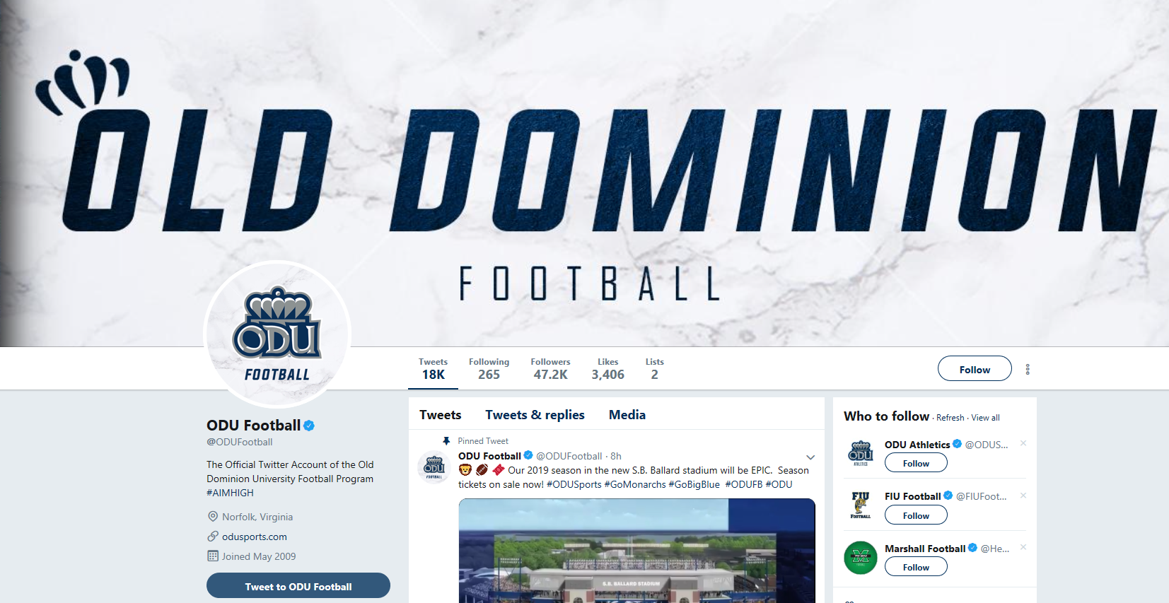
ODU football – Twitter page
https://twitter.com/ODUFootball

Slide 3
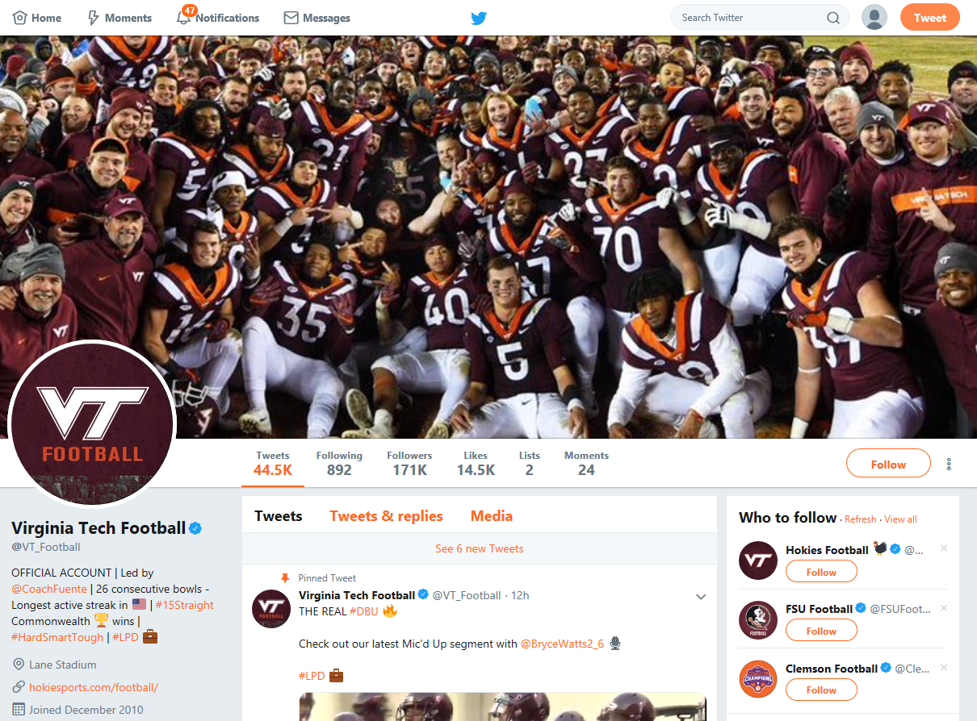
VT football – Twitter page
https://twitter.com/VT_Football

Slide 4
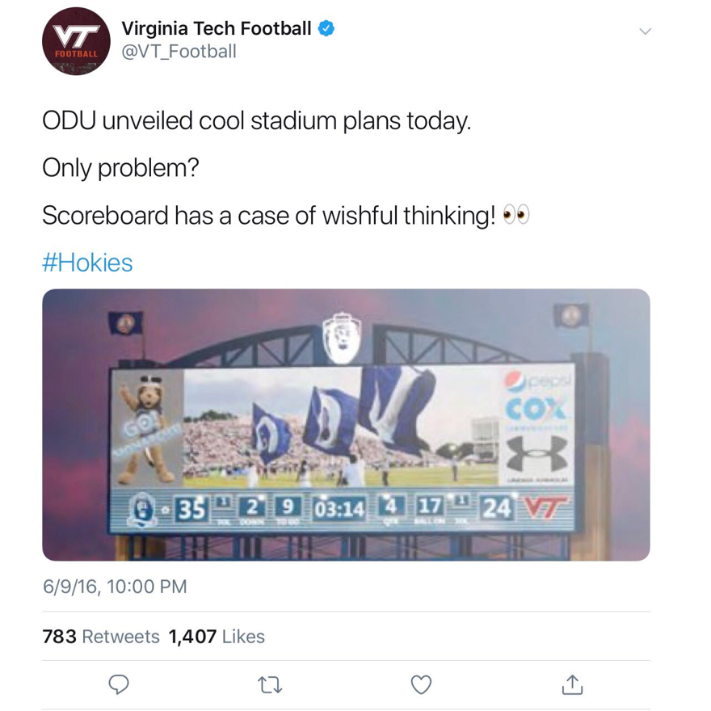
Twitter post by Virginia Tech(VT)

Slide 5
Timeline of events
ODU reveals plans for Football stadium with a score board (ODU-35 and VT-24)
2016/06/09
2016/06/09 10 pm
VT makes fun of ODU
2018/09/22
ODU wins over VT with a score of 35
Tweet resurfaces
2018/09/23
Trolls on twitter about the old tweet/on VT’s score
Before 2018/09/23
11:36 pm(as per the archive)
VT removes the post from twitter

Slide 6
ODU – New football stadium
June 9th – ODU reveal plans for a new stadium
Seats - 22,130
Approximately 2000 seats more than Foreman Field
55 million dollars budget without increase in student fees
Around 176 dollars increase in tuition pre student
To start by end of 2018 and to complete by 2019
Plans shows a football score board – ODU-35 and VT-24
https://www.nbcsports.com/washington/ncaa/odu-takes-jab-hokies-new-football-stadium-proposal
https://www.odu.edu/news/in-the-news/2016/6/odu_in_the_news_1600904600#.XKNuAphKiUk

Slide 7
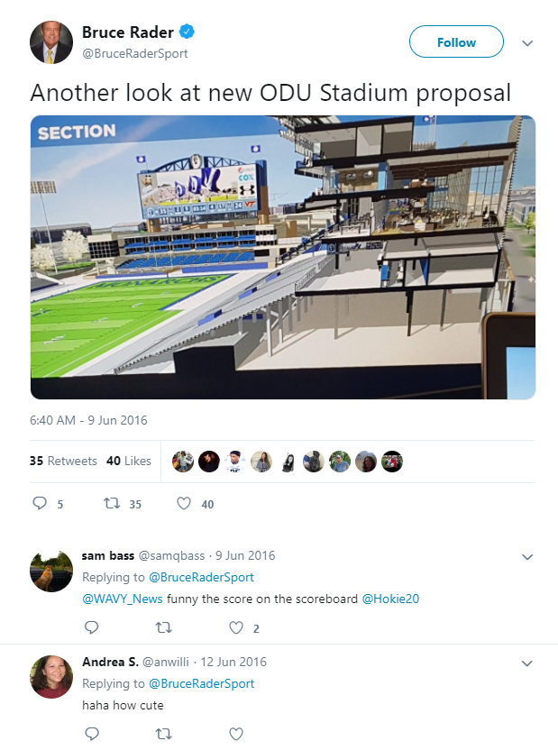
News on Twitter
https://twitter.com/BruceRaderSport/status/740901284648214528/photo/1?ref_src=twsrc%5Etfw%7Ctwcamp%5Etwee
tembed%7Ctwterm%5E740901284648214528&ref_url=https%3A%2F%2Fwww.nbcsports.com%2Fwashington%2Fncaa%2Fodu-takes-jab-hokies-new-football-stadium-proposal

Slide 8
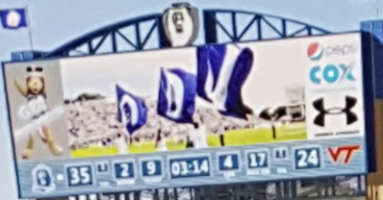
Closer look at the score board
https://twitter.com/BruceRaderSport/status/740901284648214528/photo/1?ref_src=twsrc%5Etfw%7Ctwcamp%5Etwee
tembed%7Ctwterm%5E740901284648214528&ref_url=https%3A%2F%2Fwww.nbcsports.com%2Fwashington%2Fncaa%2Fodu-takes-jab-hokies-new-football-stadium-proposal

Slide 9
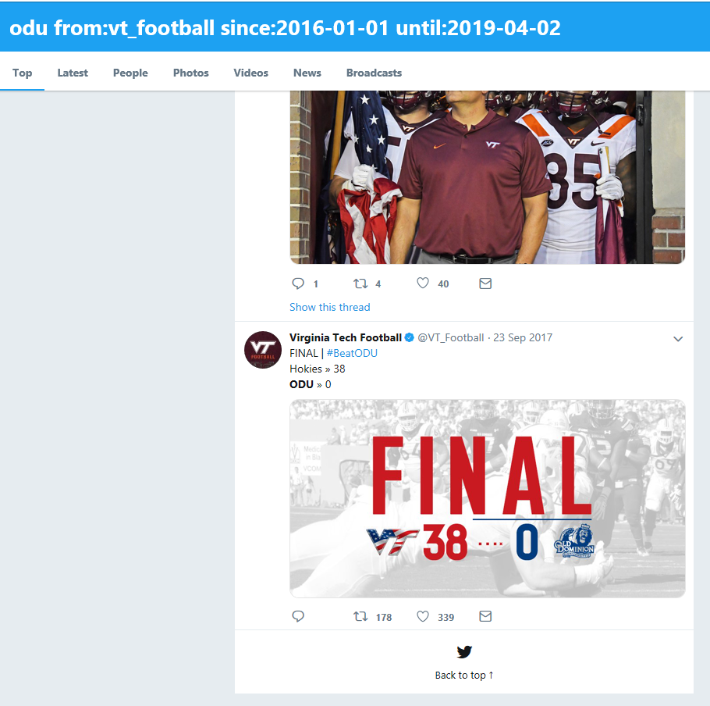
No longer on Twitter – Twitter advanced search
https://twitter.com/search?l=&q=from%3Avt_football%20since%3A2016-01-01%20until%3A2019-04-03&src=typd

Slide 10
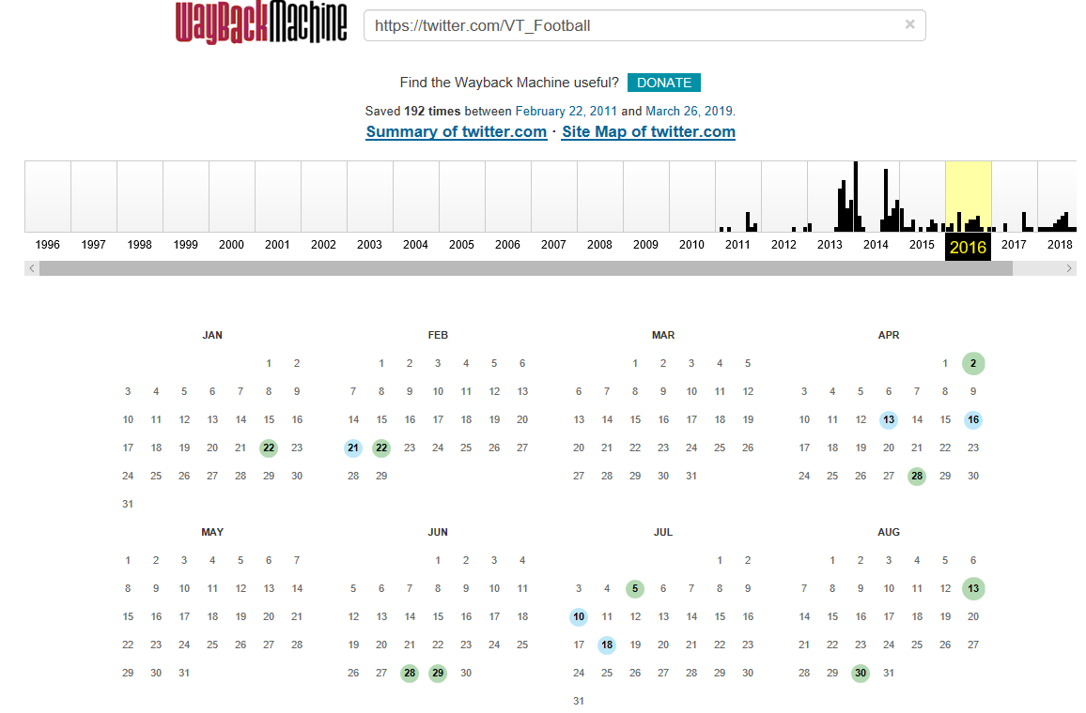
Available Mementos – VT_Football
https://web.archive.org/web/20160615000000*/https://twitter.com/VT_Football

Slide 11
Memgator – VT_Football
npabbise@sirius:~$ curl https://memgator.cs.odu.edu/memento/link/20130326132726/https://twitter.com/VT_Football
<https://twitter.com/VT_Football>; rel="original",
<http://wayback.archive-it.org/all/20110401024930/https://twitter.com/VT_Football>; rel="first memento"; datetime="Fri, 01 Apr 2011 02:49:30 GMT",
<http://wayback.archive-it.org/all/20111117131910/https://twitter.com/VT_Football>; rel="prev memento"; datetime="Thu, 17 Nov 2011 13:19:10 GMT",
<http://web.archive.org/web/20130116040228/https://twitter.com/VT_Football>; rel="memento"; datetime="Wed, 16 Jan 2013 04:02:28 GMT",
<http://wayback.archive-it.org/all/20131009083355/https://twitter.com/VT_Football>; rel="next memento"; datetime="Wed, 09 Oct 2013 08:33:55 GMT",
<http://wayback.archive-it.org/all/20190326194657/https://twitter.com/VT_Football>; rel="last memento"; datetime="Tue, 26 Mar 2019 19:46:57 GMT",

Slide 12
No references to ODU in the last available memento of VT
npabbise@fqdn:~$ curl http://wayback.archive-it.org/all/20190326194657/https://twitter.com/VT_Football | grep ODU
% Total % Received %Xferd Average Speed Time Time
Dload Upload Total Spent
100 663k 100 663k 0 0 511k 0 0:00:01 0:00:01
Current Time
Speed Left
511k --:--:--
NO OUTPUT

Slide 13
2018 Sep 22 – ODU vs VT
Foreman Field
VT’s first play at ODU
ODU score 49 and VT score 35
VT’s score reflects ODU’s score (as in the plans for new stadium)
Twitter trolls VT for the old tweet on ODU

Slide 14
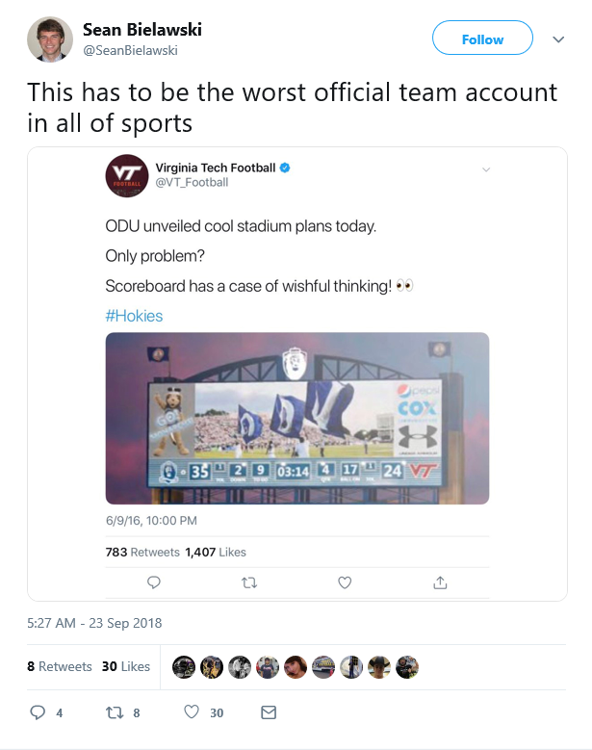
Old tweet resurfaces
https://twitter.com/SeanBielawski/status/1043839282534862848

Slide 15
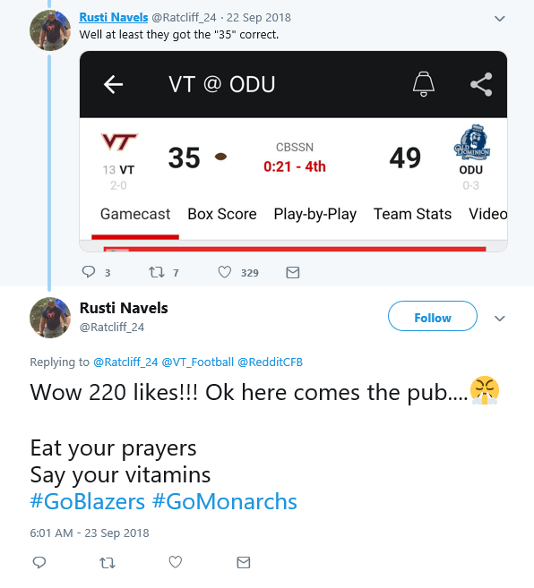
Troll tweets on VT scoring “35”
https://twitter.com/Ratcliff_24/status/741223084477288448/photo/1?ref_src=twsrc%5Etfw%7Ctwcamp%5Etweetembed%7
Ctwterm%5E1043691086487736321&ref_url=https%3A%2F%2Fsportsnaut.com%2F2018%2F09%2Ffans-roast-virginia-tech-over-old-tweet-trolling-old-dominion%2F

Slide 16
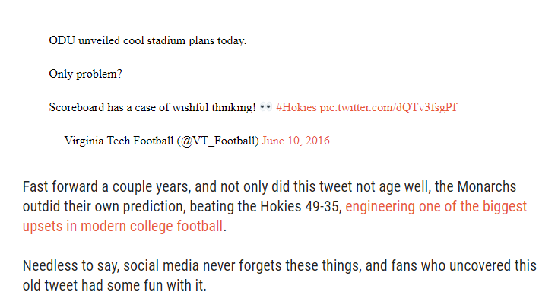
Sports news about the old troll tweet
https://sportsnaut.com/2018/09/fans-roast-virginia-tech-over-old-tweet-trolling-old-dominion/

Slide 17
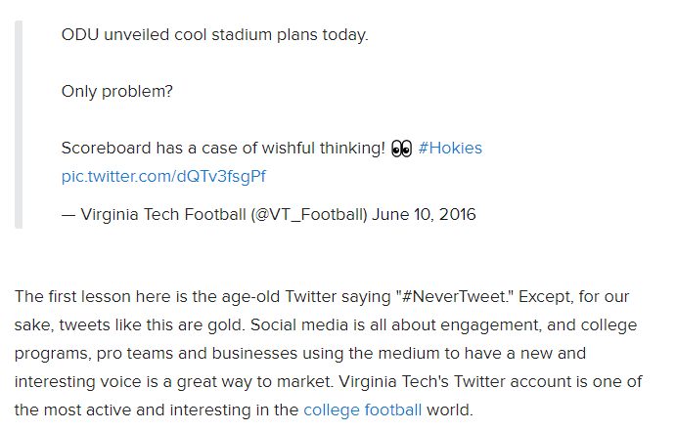
Another source
https://www.cbssports.com/college-football/news/look-virginia-techs-2016-troll-tweet-about-old-dominion-has-come-back-to-haunt-them/

Slide 18
Link of the actual twitter post from different media sources
Link of the actual tweet - https://twitter.com/VT_Football/status/741087562127679488/photo/1
Sources:
npabbise@sirius:~$ curl https://memgator.cs.odu.edu/memento/link/20130326132726/https://www.cbssports.com/college-football/news/look-virginia-techs-2016-troll-tweet-about-old-dominion-has-come-back-to-haunt-them/
<http://web.archive.org/web/20180923113610/https://www.cbssports.com/college-football/news/look-virginia-techs-2016-troll-tweet-about-old-dominion-has-come-back-to-haunt-them/>; rel="first last memento"; datetime="Sun, 23 Sep 2018 11:36:10 GMT",
https://sportsnaut.com/2018/09/fans-roast-virginia-tech-over-old-tweet-trolling-old-dominion/ -- No mementos present
https://www.cbssports.com/college-football/news/look-virginia-techs-2016-troll-
tweet-about-old-dominion-has-come-back-to-haunt-them/ -- Only one memento present

Slide 19
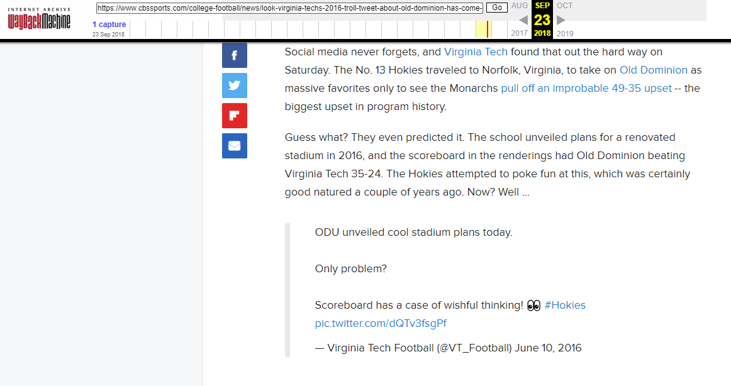
Archive from 2018 – news about old tweet
https://web.archive.org/web/20180923113610/https://www.cbssports.com/college-football/news/look-virginia-techs-2016-troll-tweet-about-old-dominion-has-come-back-to-haunt-them/

Slide 20
Conclusion
Virginia Tech posted the picture on Twitter on 2016/06/09
In response to a picture released by ODU that says ODU won against VT(in a Football match) earlier that day
On 2018/09/22, VT lost to ODU in a Football match
The post was removed on 2018/09/23 before 11:36 pm, after people starting trolling VT over the post.

